Slide 1
Data Science Project
Justus Phillips

Slide 2
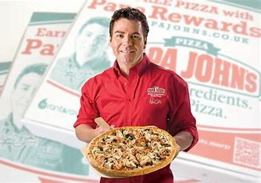
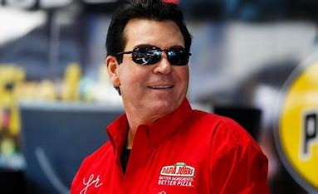
Problem Statement
Papa John wants to break off from his current company of his namesake and start a new food company. He’s not sure if he wants to continue making pizza for a living, or try something new. As he doesn’t have his finger on the pulse of what’s popular and a good investment of money, he’s hired me to dig deep and guide him on whether or not he should continue to make good pizza for his new company.

Slide 3
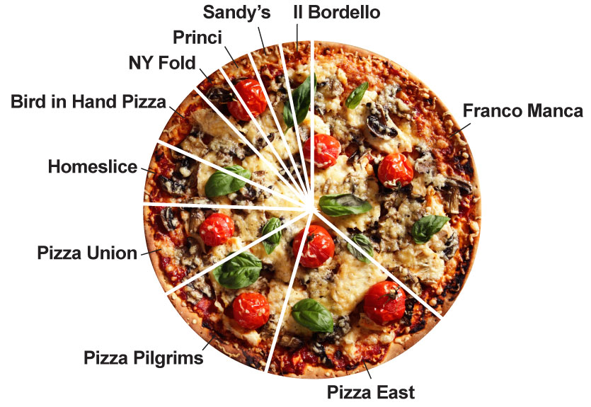
Analysis Benefits
Papa really just wants to make some more money. The benefits of this analysis will really allow him to have be confident in his decision of business and feel comfortable going all in knowing that it will most likely be a successful venture, and not a complete waste of his precious time and money, as well as where and when his new shop should be open.

Slide 4
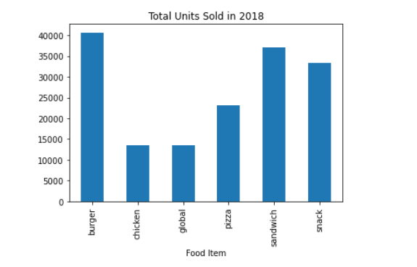
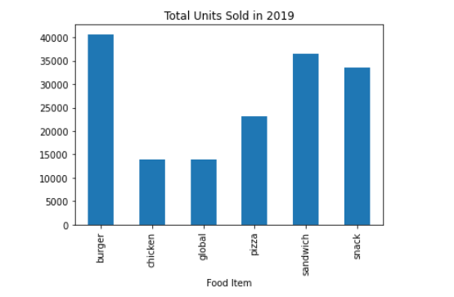
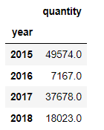
Pizzas Sold
Pizza sales may not be the highest of the bunch - but that’s actually a good thing. This shows that pizza just isn’t what it used to be, and papa can come swoop in and take all the customers by the taste buds with his delicious pie.

Slide 5
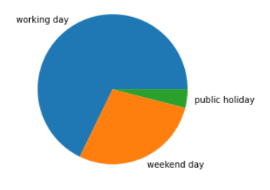
Pizzas Days
This pie graph shows the amount of pizzas sold on the various times of the week - those being weekdays, weekends, and holidays. This shows that the majority of pizzas are actually sold during the weekday - this means that if papa wants to take vacations over the weekend, it won’t be a huge detriment to his business.
68%
4%
28%

Slide 6
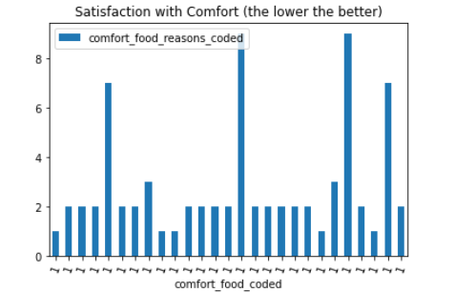
Pizza Comfort
This data isolates the people that enjoy pizza as their comfort food, and compares it to how comfortable they’re actually able to be in life. While there are some obvious outliers, the general populace of pizza eaters has GREAT comfort, furthering convincing papa that he needs to spread more pizza joy into the world.

Slide 7
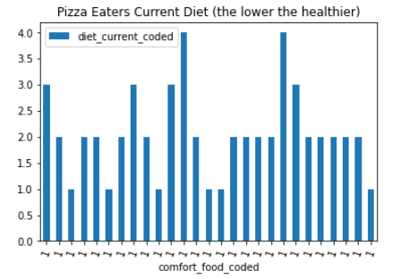
Better Ingredients, Better Pizza
Similar to the data before, this data takes the pizza eaters and, instead of judging comfort, judges their dietary restrictions. Do they push to eat healthier? As you can see, not many pizza eaters push to eat healthy - and yet another reason for papa to make more pizza!! Give the people a healthier pizza alternative to the greasy corner store Dominoes

Slide 8
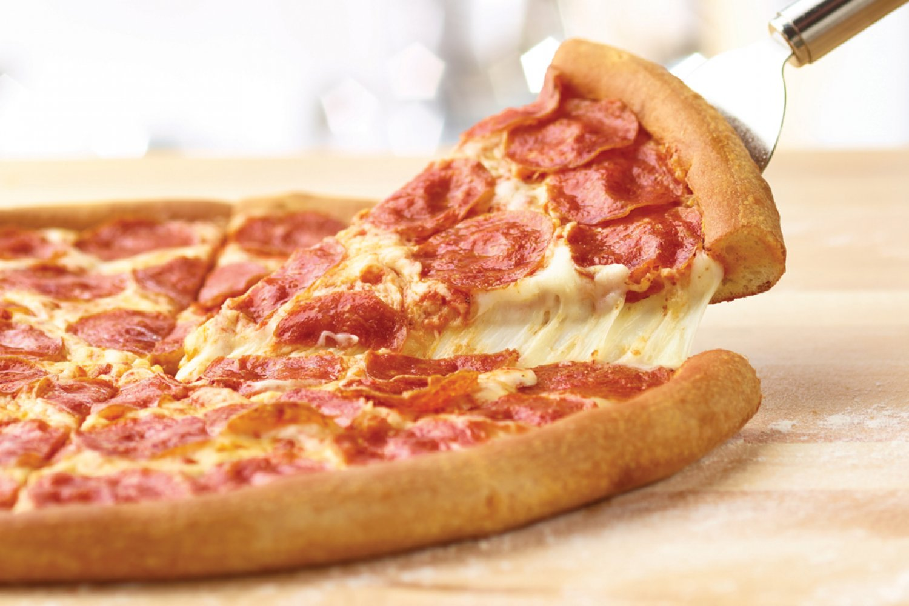
Pizza Machine
A machine learning code was created to determine the factors that determine which factors in a person determine their preference to eat pizza - and with an 85% prediction accuracy, those factors are:
Whether or not they ate breakfast that morning
Whether or not they can be comfortable
Whether or not they find life rewarding

Slide 9
Next Bites
My suggestion for Papa John is that he go out and create a small pizza business in an area near nursing homes, where the people are generally happy, satisfied with life, and looking for healthy options. While he could go out and make another type of food, it’s just too much of a risk, with too much competition in the other food fields. But when it comes to pizza? No one out Papas the John. If I were given more time and resources, I could find more potential pizza locations for Papa, as well as determine people’s preferred pizza ingredients to help boost the mainstream appeal to the pizza.

